Slide 1
Analysis of single-cell RNA-seq data (I)
Hao Wu
Department of Biostatistics and Bioinformatics
Rollins School of Public Health
Emory University
Ziyi Li
Department of Biostatistics
The University of Texas MD Anderson Cancer Center
ENAR 2021 short course
March 2021

Slide 2
Course outline
8-9:15: Intro and data preprocessing.
9:15-9:45: Lab: preprocessing and visualization.
10-11:15: Normalization, batch effect, imputation, DE, simulator.
11:15-12: Lab: Normalization, batch effect, imputation, DE, simulator
12-1: lunch break
1-2: Clustering and pseudotime construction
2-2:30: Lab: Clustering and pseudotime construction
2:45–3:30: Supervised cell typing & related single cell data sources
3:30-4: Lab: supervised cell typing.
4:15-5: scRNA-seq in cancer

Slide 3
Other useful resources
https://github.com/theislab/single-cell-tutorial/
https://scrnaseq-course.cog.sanger.ac.uk/website/index.html
https://broadinstitute.github.io/2019_scWorkshop/

Slide 4
Outline for this session
Background
Scientific motivation
Technology
UMI
Pre-processing: Alignment, QC, quantification
Data visualization: tSNE, UMAP

Slide 5
Background
Most of the biological experiments are performed on “bulk” samples, which contains a large number of cells (millions).
The “bulk” data measure the average signals (gene expression, TF binding, methylation, etc.) of many cells.
The bulk measurement ignores the inter-cellular heterogeneities:
Different cell types.
Variation among the same cell type.

Slide 6
Single cell biology
The study of individual cells.
The cells are isolated from multi-cellular organism.
Experiment is performed for each cell individually.
Provides more detailed, higher resolution information.
High-throughput experiments on single cell is possible.

Slide 7
Single cell sequencing
Different types of sequencing at the single-cell level:
DNA-seq
ATAC-seq, ChIP-seq
BS-seq
RNA-seq
Very active research field in the past few years.

Slide 8
Basic experimental procedure
Isolation of single cell. Techniques include
Laser-capture microdissection (LCM)
Fluorescence-activated cell sorting (FACS)
Microfluidics
Open the cell and obtain DNA/mRNA/etc.
PCR amplification to get enough materials.
Perform sequencing.

Slide 9
Single cell RNA-seq (scRNA-seq)
The most active in the single cell field.
Scientific goals:
Composition of different cell types in complex tissues.
New/rare cell type discovery.
Gene expression, alternative splicing, allele specific expression at the level of individual cells.
Transcriptional dynamics (pseudotime construction).
Above can be investigated and compared spatially, temporally, or under different biological condition.

Slide 10
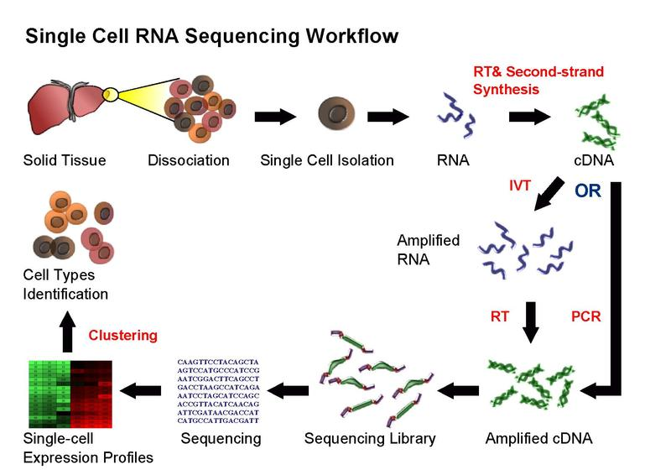
Figure source: Wikipedia

Slide 11
Technologies by capturing method
Plate-based methods: Smart-Seq/Smart-Seq2, CEL-seq:
Sort cells into the wells on a multi-well plate.
Lower throughput (in terms of number of cells).
High sequencing depth
Can be combined with FACS for cell sorting.
Better at detecting low expression genes
Good for isoform analysis, allele specific expression

Slide 12
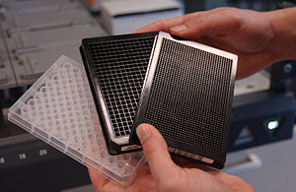
Microwell plates
Figure source: wikipedia

Slide 13
Droplet-based methods: Drop-seq, inDrop, 10x genomics
Put each cell in a nanoliter droplet with a bead.
Each droplet is a reactor for PCR.
Each bean has a unique barcode, so all beads can be pooled and sequenced together.
Much higher throughput in terms of number of cells.
Lower sequencing depth.
Good for identifying cell subpopulations.

Slide 14
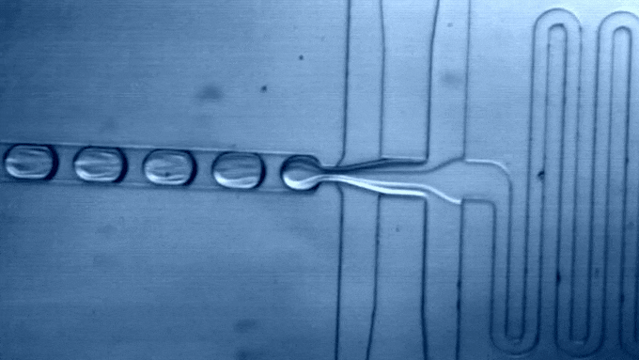
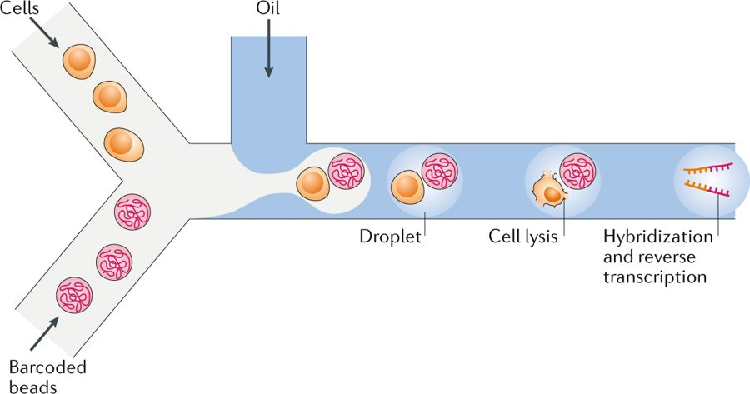
Figures: Macosko et al. 2015, Potter SS. 2018

Slide 15
Technologies over the years
Svensson et al. (2017) Nature Protocols

Slide 16
Unique molecule identifier (UMI) NM 2014

Slide 17
UMI
PCR introduces nonlinear amplification bias
Factors influencing PCR: sequence content, chromatin structure, etc.
UMIs are short sequence tag added to each unique mRNA molecular before PCR, for reducing PCR bias.
Number of possible UMIs = 4^{L}, where L is the length of the UMI

Slide 18
Multiplexing
Technology to pool many cells together for each sequencing lane.
Each cell is uniquely marked by a barcode (short sequence tag).
A combination of barcode and UMI can quantify unique transcripts in each cell.

Slide 19
UMI + barcode
Assumption: number of identical mRNA is small (say, <100) for most genes.
Use 5-bp UMI (can mark 1024 molecules)
When a transcript has, say, 20 mRNA molecules, the probability of two molecule having the same UMI is small.
Use 6-bp barcode to identify cells (up to 4096 cells).
Use molecule counts instead of read counts as gene expression measurements.

Slide 22
UMI provides better measurements and reproducibility

Slide 23
Single nucleus RNA-seq (snRNA-seq)
Profile gene expressions in nucleus, instead of the whole cell
Transcripts can be in cytoplasm and nucleus
Useful when the cells are difficult to isolate
Frozen tissues
Highly connected cells such as neurons
Analysis methods are similar.

Slide 24
Other single cell assays
CITE-seq (Cellular Indexing of Transcriptomes and Epitopes by Sequencing)
Jointly profile transcriptome and proteome.
scNMT-seq (single-cell Nucleosome, Methylation and Transcription sequencing)
Jointly profile chromatin accessibility, DNA methylation, and transcription

Slide 25
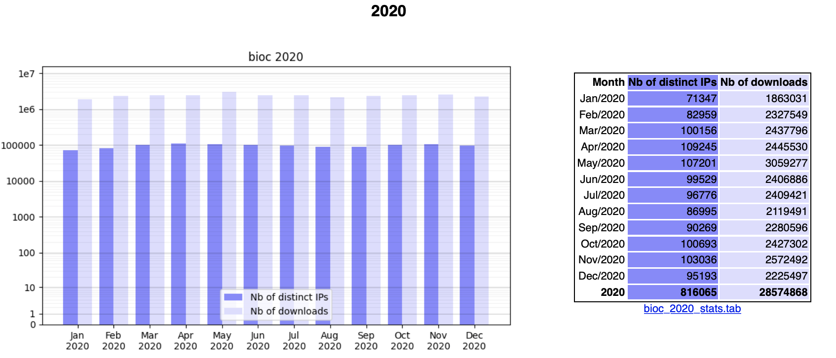
Brief introduction to Bioconductor
A collection of R packages
The de facto language for genomic data analysis.

Slide 26
Functionalities
“Bioconductor provides tools for the analysis and comprehension of high-throughput genomic data. Bioconductor uses the R statistical programming language, and is open source and open development.”
Provides close to 2000 packages for:
microarrays.
second generation sequencing.
other high-throughput assays.
annotation.
Most of the packages are contributed.

Slide 27
Bioconductor installation
Use BiocManager::install().
Basic installation: installing default (core) packages:
if (!requireNamespace("BiocManager")) install.packages("BiocManager")
BiocManager::install()
Installing a specific package:
BiocManager::install("limma")

Slide 28
Data processing
Preprocessing
QC
Alignment
Expression quantification
Normalization
Batch effect correction
Imputation

Slide 29
scRNA-seq data preprocessing
QC:
FastQC is a popular tool for checking a single sample.
MultiQC: create a single report with interactive plots for multiple QC reports.
Read trimming:
cutadapt (with a wrapper Trim Galore!)
Bioconductor package “scater” provides useful and easy-to-use functions for QC and data visualization.

Slide 30
Alignment and quantification
Alignment
RNA-seq alignment software (Tophat, STAR, HISAT, etc.) can be used.
Some commercial software, such as CellRanger for 10x genomics data.
Quantification (to obtain count matrix from aligned reads)
Most alignment software provide such functionality.

Slide 31
Some data characteristics
Data is very sparse (many zeros), especially for Drop-seq data.
Number of transcripts detected is much lower compared to bulk RNA-seq under the same sequencing depth.
Wu et al. 2013 Nature Method

Slide 32
Bulk and aggregated single cell expressions have good correlation.
Wu et al. 2013 Nature Method

Slide 33
Expression levels for a gene in different cells sometimes show bimodal distribution.
Wu et al. 2013 Nature Method

Slide 34
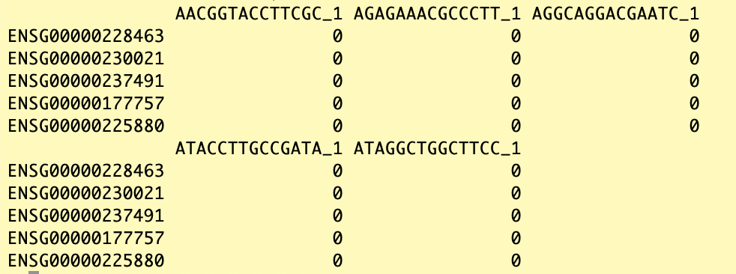
scRNA-seq data after processing
A matrix of read counts: rows are genes and columns are cells

Slide 35
A few useful R packages
SingleCellExperiment:
Bioconductor package. Defines “SingleCellExperiment” class for storing single cell data: expression matrix, gene and cell information, etc.
Visualization tools:
tSNE
UMAP

Slide 36
SingleCellExperiment
Installation:
BiocManager::install("SingleCellExperiment")
Create SingleCellExperiment object:
sce <- SingleCellExperiment(list(counts=counts),
colData=DataFrame(label=celllabels),
rowData=DataFrame(genenames=genenames),
metadata=list(study="GSE111111")
)
Functions to access contents of the object: counts, rowData, colData, etc.

Slide 37
t-SNE: a useful visualization tool
t-SNE (t-distributed stochastic neighbor embedding): visualize high-dimensional data on 2-/3-D map.
When project high-dimensional data into lower dimensional space, preserve the distances among data points.
This alleviate the problem that many clusters overlap on low dimensional space.
Try to make the pairwise distances of points similar in high and low dimension.
Has “tsne” and “Rtsne” package on CRAN.

Slide 39
Example code for t-SNE
library(Rtsne)
tsne_model_1 = Rtsne(datamatrix,
check_duplicates=FALSE, pca=TRUE,
perplexity=30, theta=0.5, dims=3)
tsne_out = as.data.frame(tsne_model_1$Y)
plot(tsne_out$V1, tsne_out$V2,
pch = 19, cex = 0.4, col = mycolor)
legend("bottomleft", col = mycolor,
legend = uniqCT, pch = 19,
cex = 0.5, bty = "n")

Slide 40
UMAP: a newer (and better?) visualization tool
UMAP (uniform manifold approximation and projection): a recently developed dimension reduction tool
“Comparing the performance of UMAP with five other tools, we find that UMAP provides the fastest run times, highest reproducibility and the most meaningful organization of cell clusters. ” ---- Betcht et al. 2018 Nat Biotech
“UMAP, which is based on theories in Riemannian geometry and algebraic topology, has been developed, and soon demonstrated arguably better performance than t-SNE due to its higher efficiency and better preservation of continuum.” ---- Mu et al. 2018 GBP
Has “umap” package on CRAN.

Slide 41
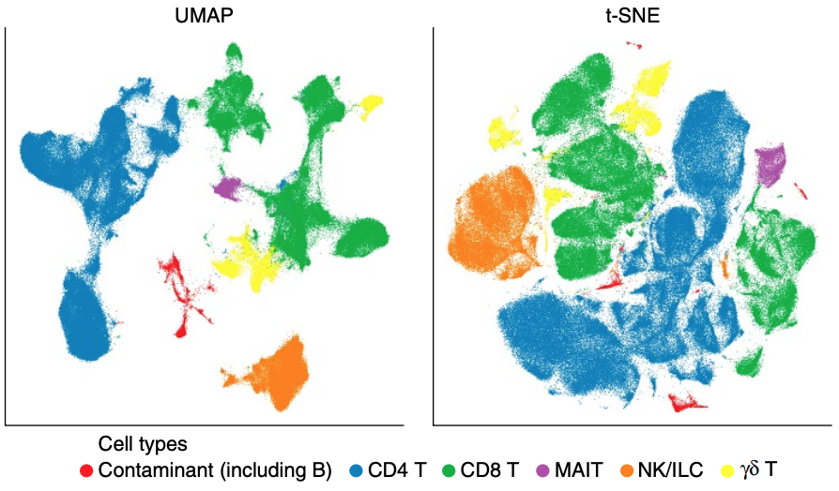
Betcht et al. 2018 Nat Biotech

Slide 42
Example code for UMAP
library(umap)
sim_umap <- umap(datamatrix)
sim_umap2 <- sim_umap$layout
colnames(sim_umap2) <- c("UMAP1", "UMAP2")
plot(sim_umap2[,1], sim_umap2[,2],
pch = 19, cex = 0.4, col = mycolor)
legend("bottomleft", col = mycolor,
legend = uniqCT, pch = 19,
cex = 0.5, bty = "n")

